Slide 1
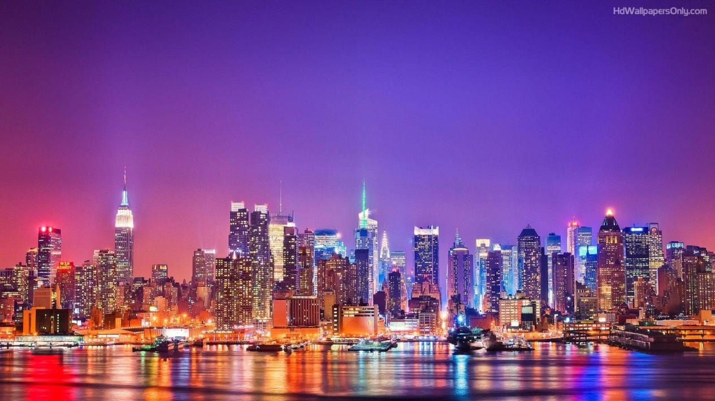
NEW YORK TRIP
13th February – 17th February 2017

Slide 2
Memories of last year…

Slide 3
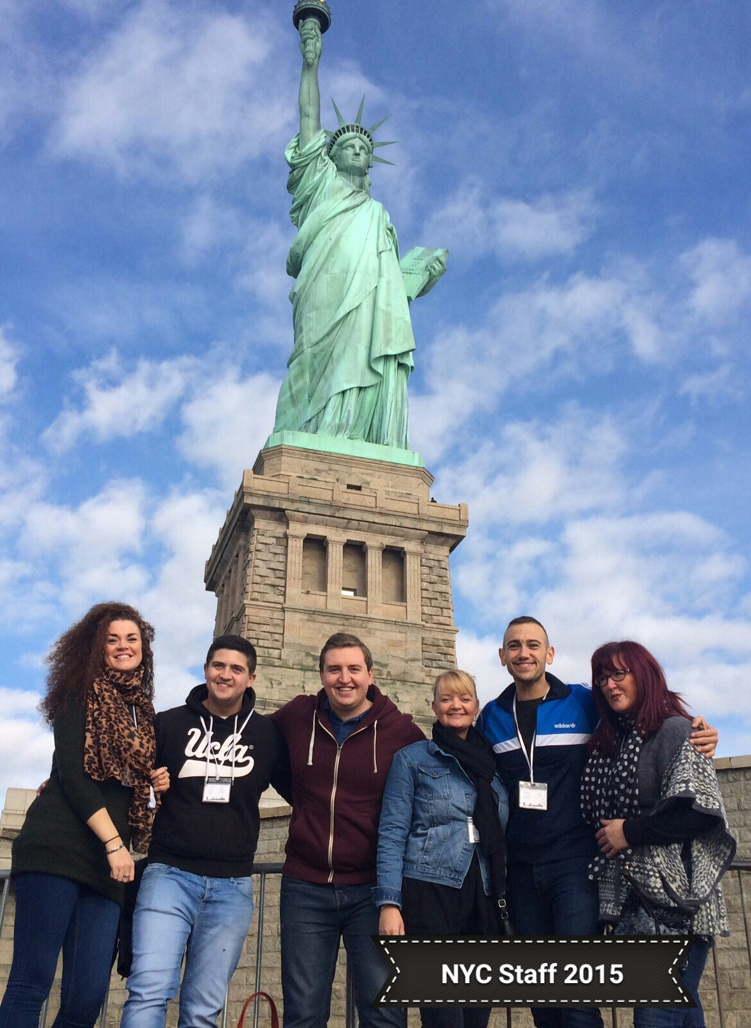
Memories of
last year…

Slide 4
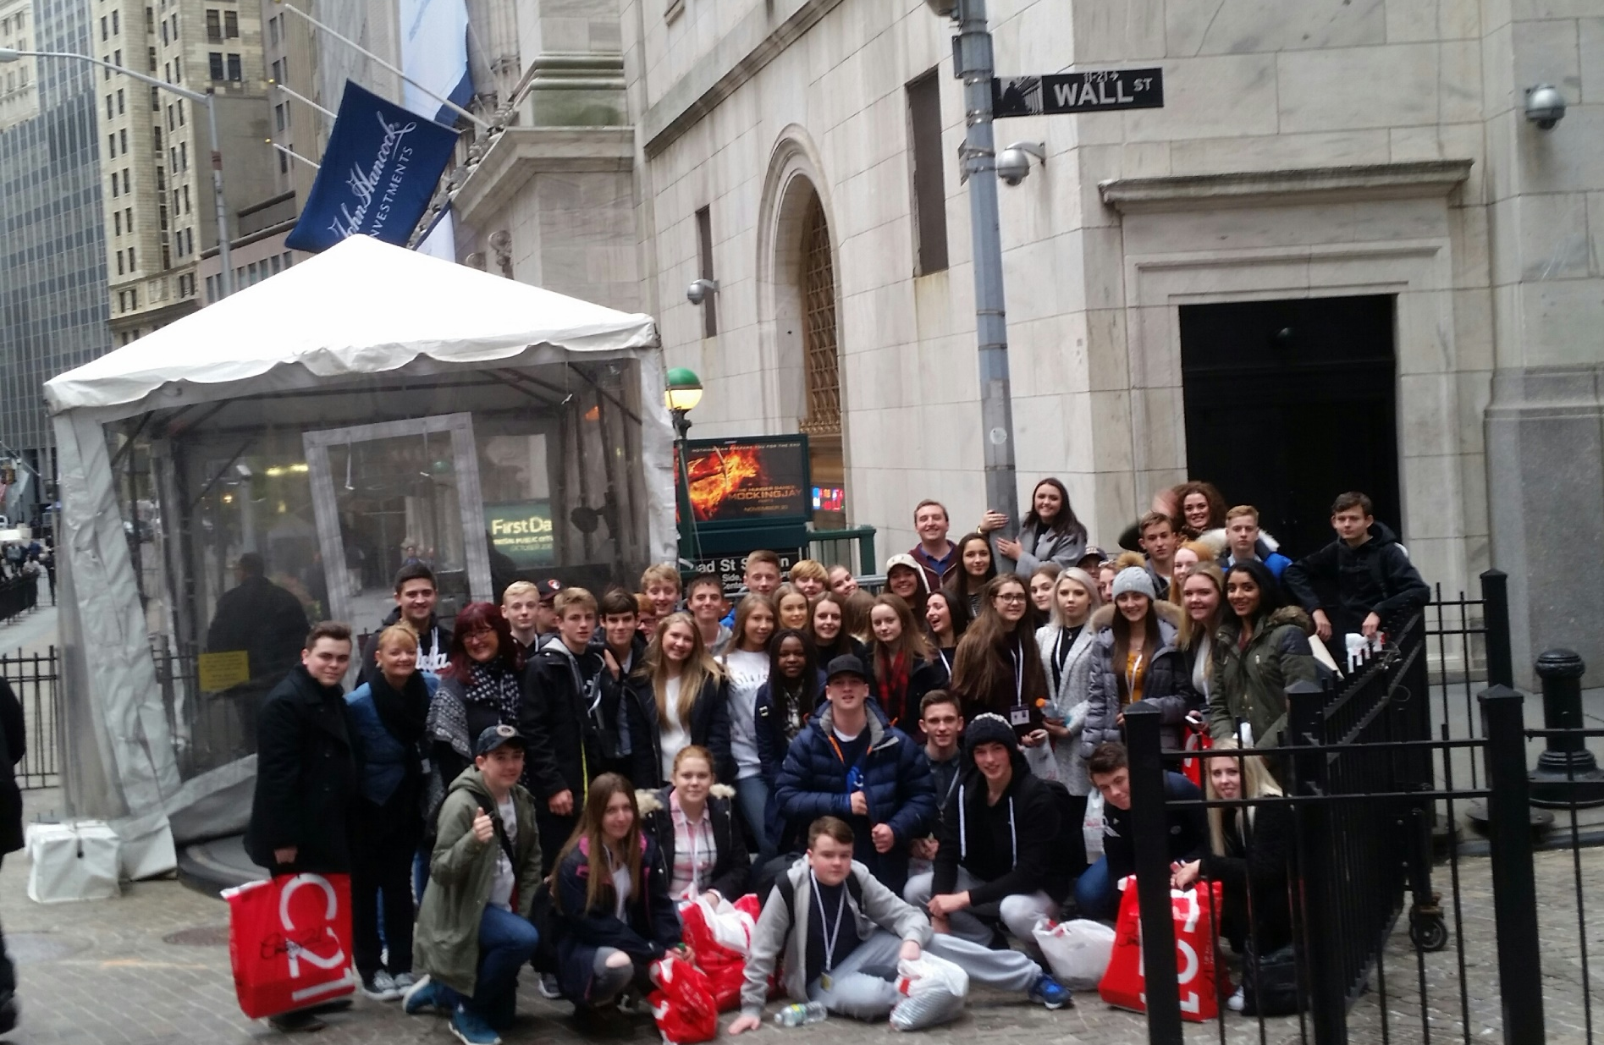
Memories of last year…

Slide 6
Why RE & NYC?
To reflect on war, religion and terrorism in the 21st Century through visiting Ground Zero

Slide 7
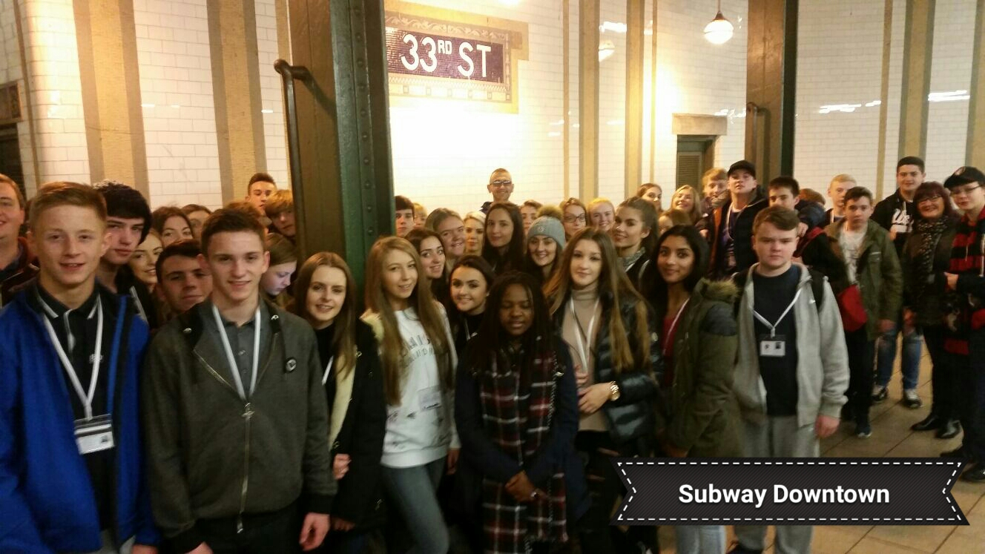
Memories of last year…

Slide 8
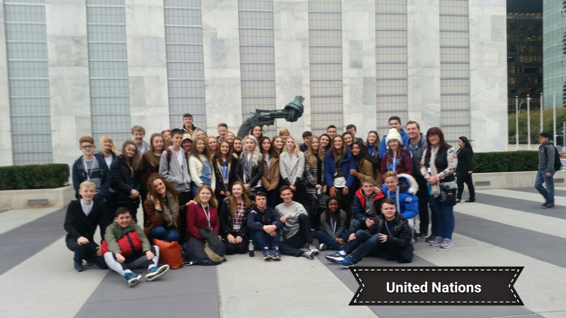
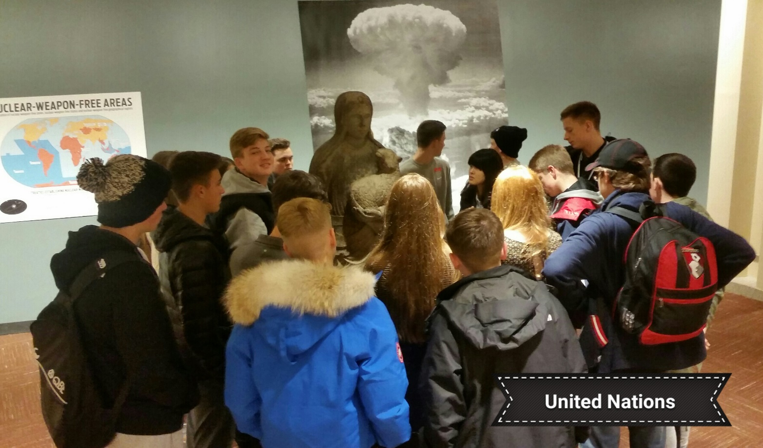
Memories of last year…

Slide 9
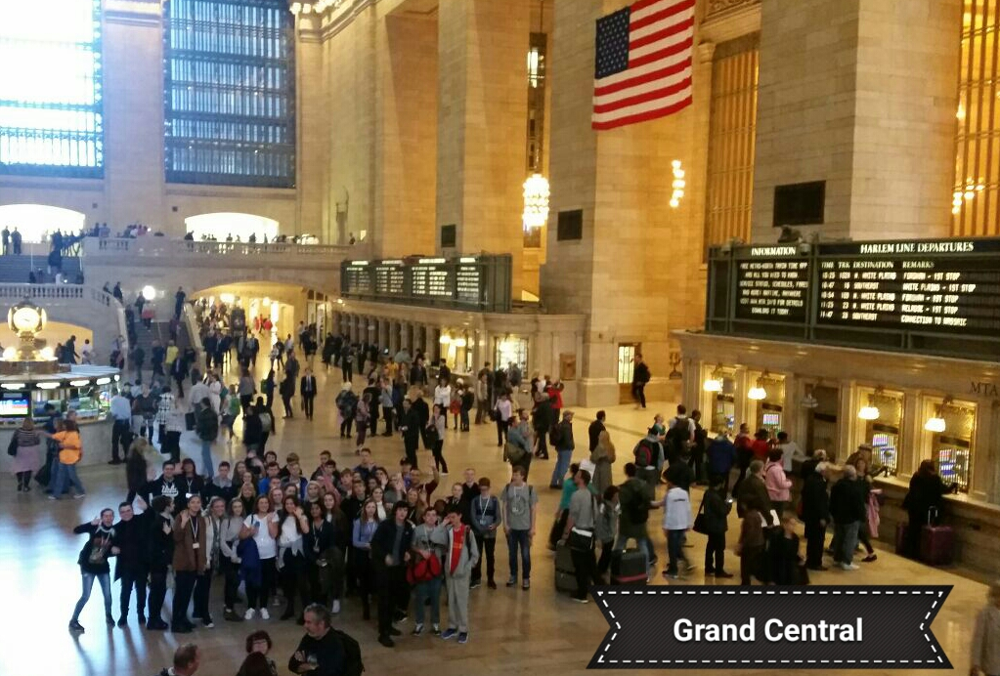
Memories of last year…

Slide 11
What our Pupils told us last year…
‘I would recommend the trip to other year groups, because it is an absolutely amazing experience’ – Liam Bott

Slide 12
NEW YORK TRIP
13th February – 17th February 2017

Slide 13
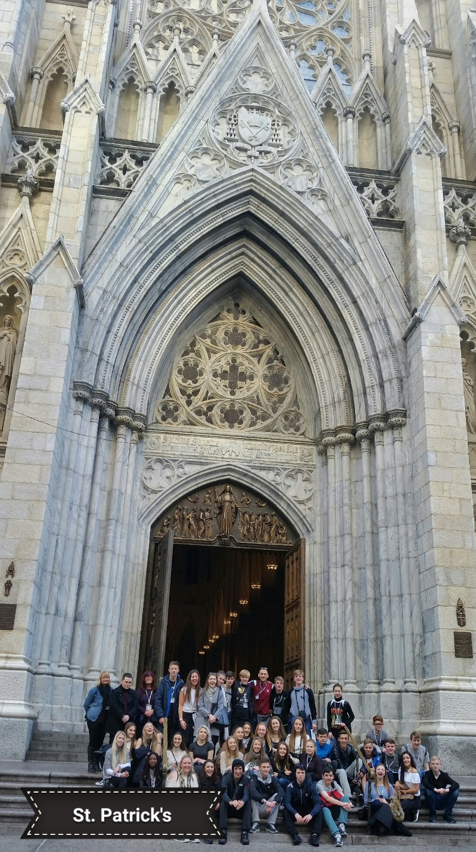
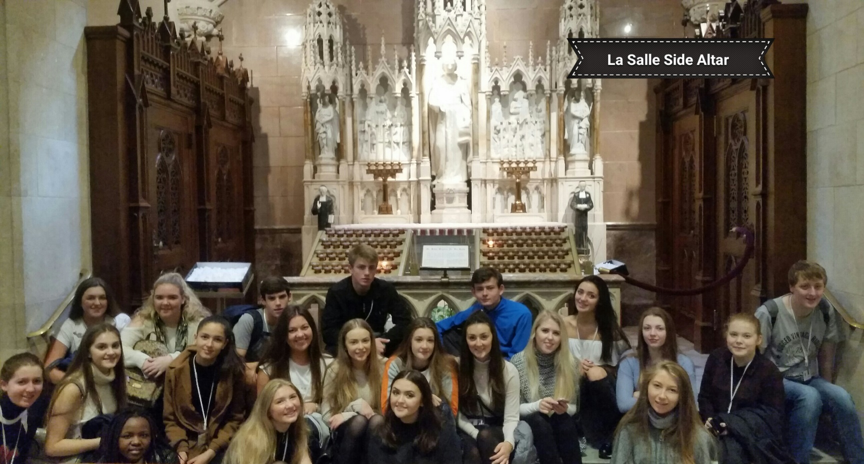
Memories of last year…

Slide 14
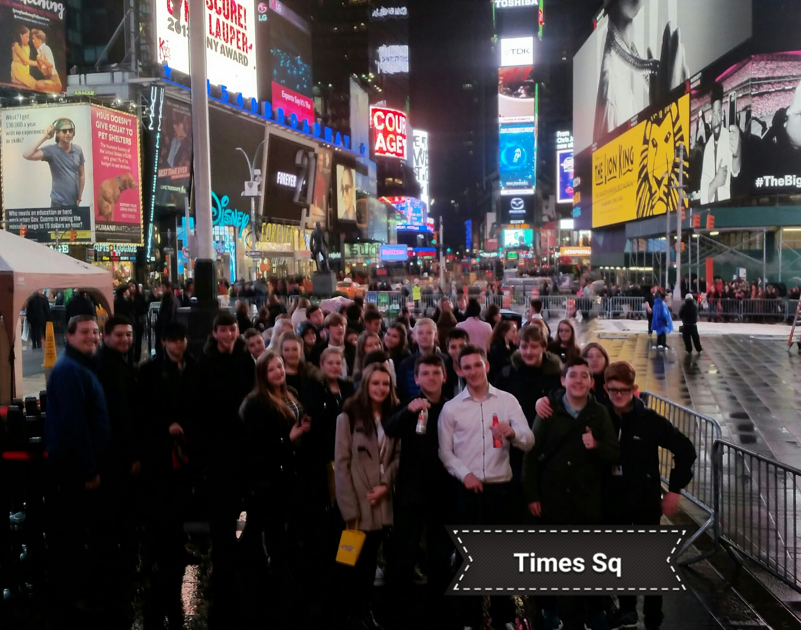
Memories
of last
year…

Slide 15
What our Pupils told us last year…
‘The trip was worth every penny and NYC is somewhere that everybody needs to visit. Anybody who gets the chance to go is extremely lucky’
– Aidan Smithson

Slide 16
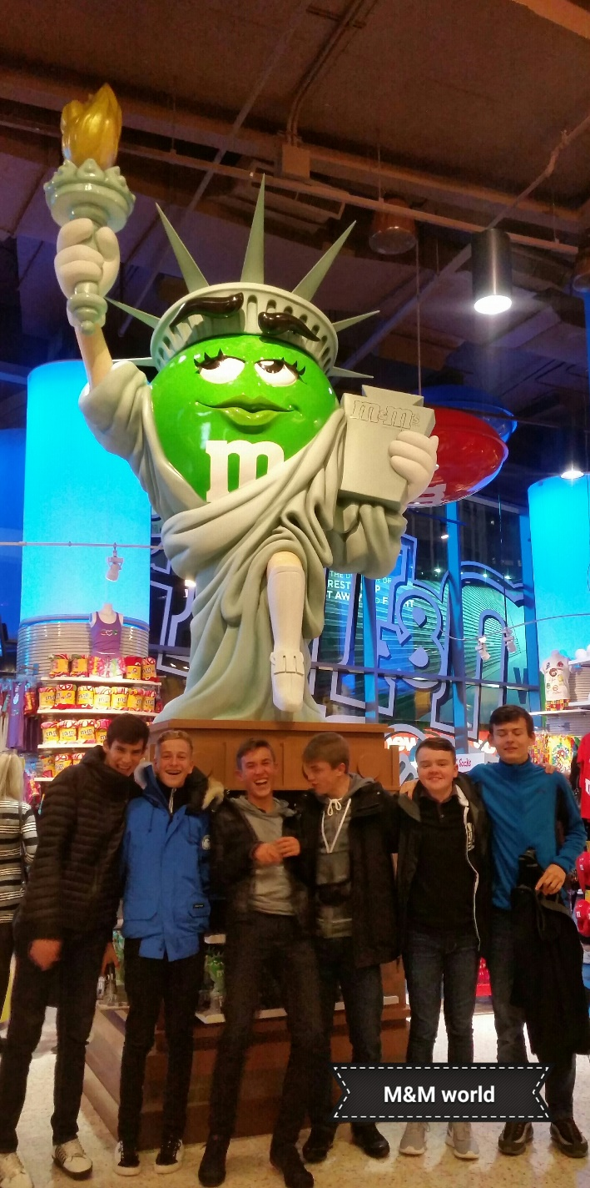
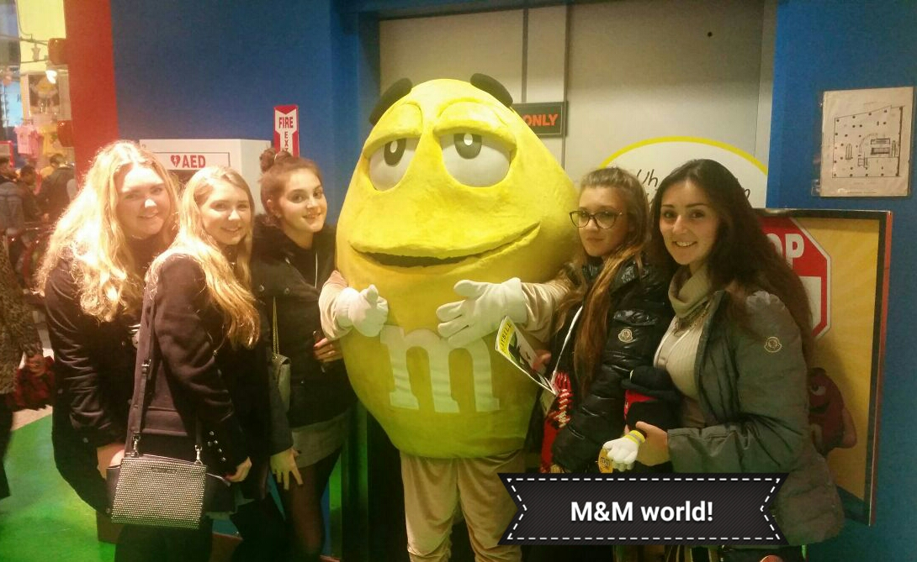
Memories of
last year…

Slide 18
Why RE & NYC?
To explore the United Nations and experience it’s Head-Quarters

Slide 19
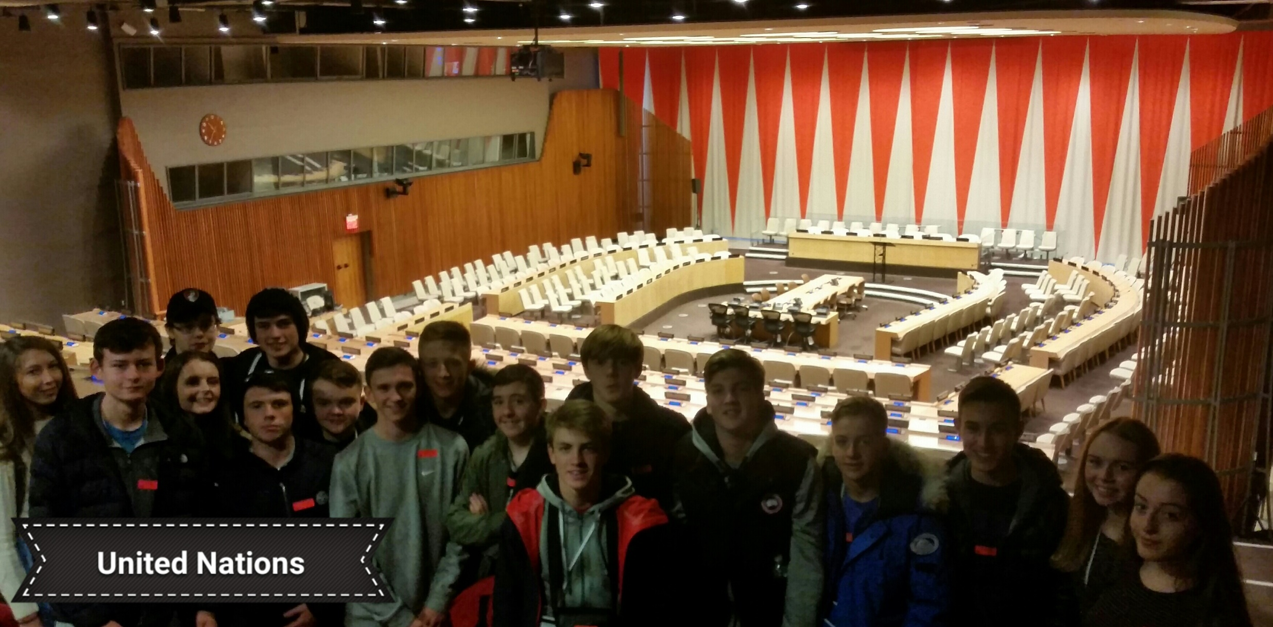
Memories of last year…

Slide 20
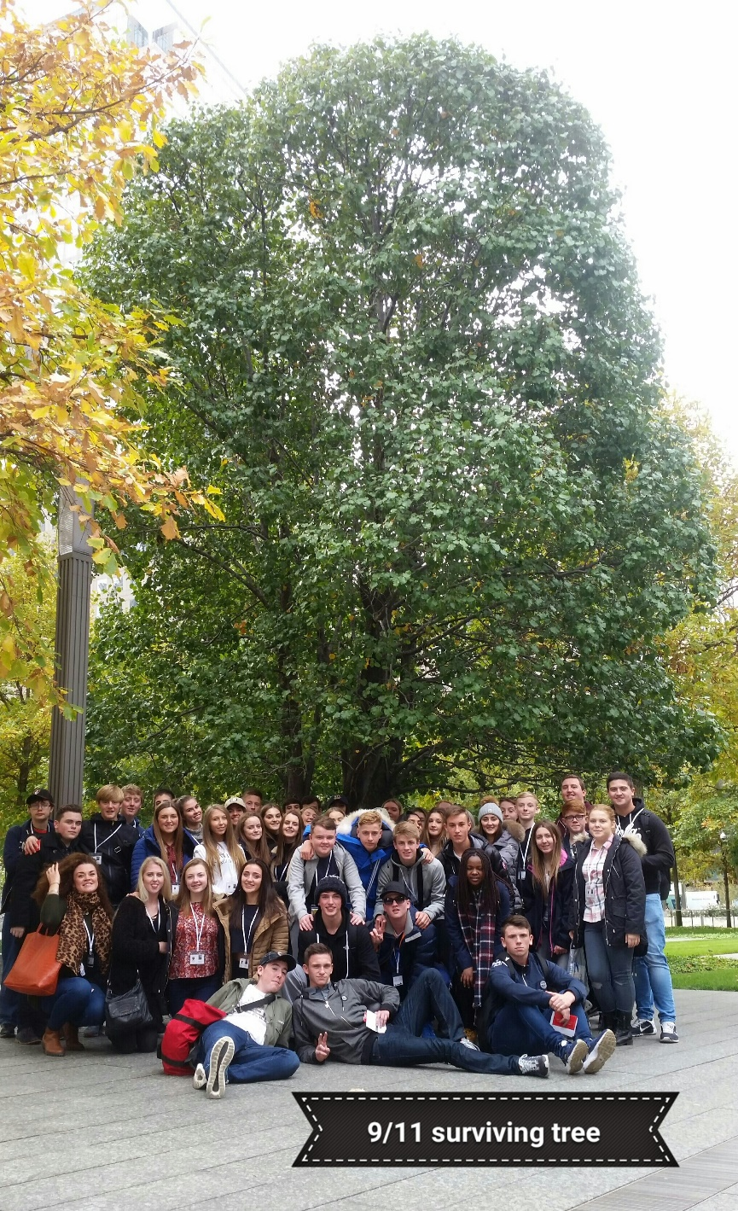
Memories of last year…

Slide 21
What our Pupils told us last year…
‘I learnt a lot on the trip. I learnt about migrants who arrived at Ellis Island. Most importantly, I learnt a lot about my own independence’ – Hannah Clisby

Slide 22
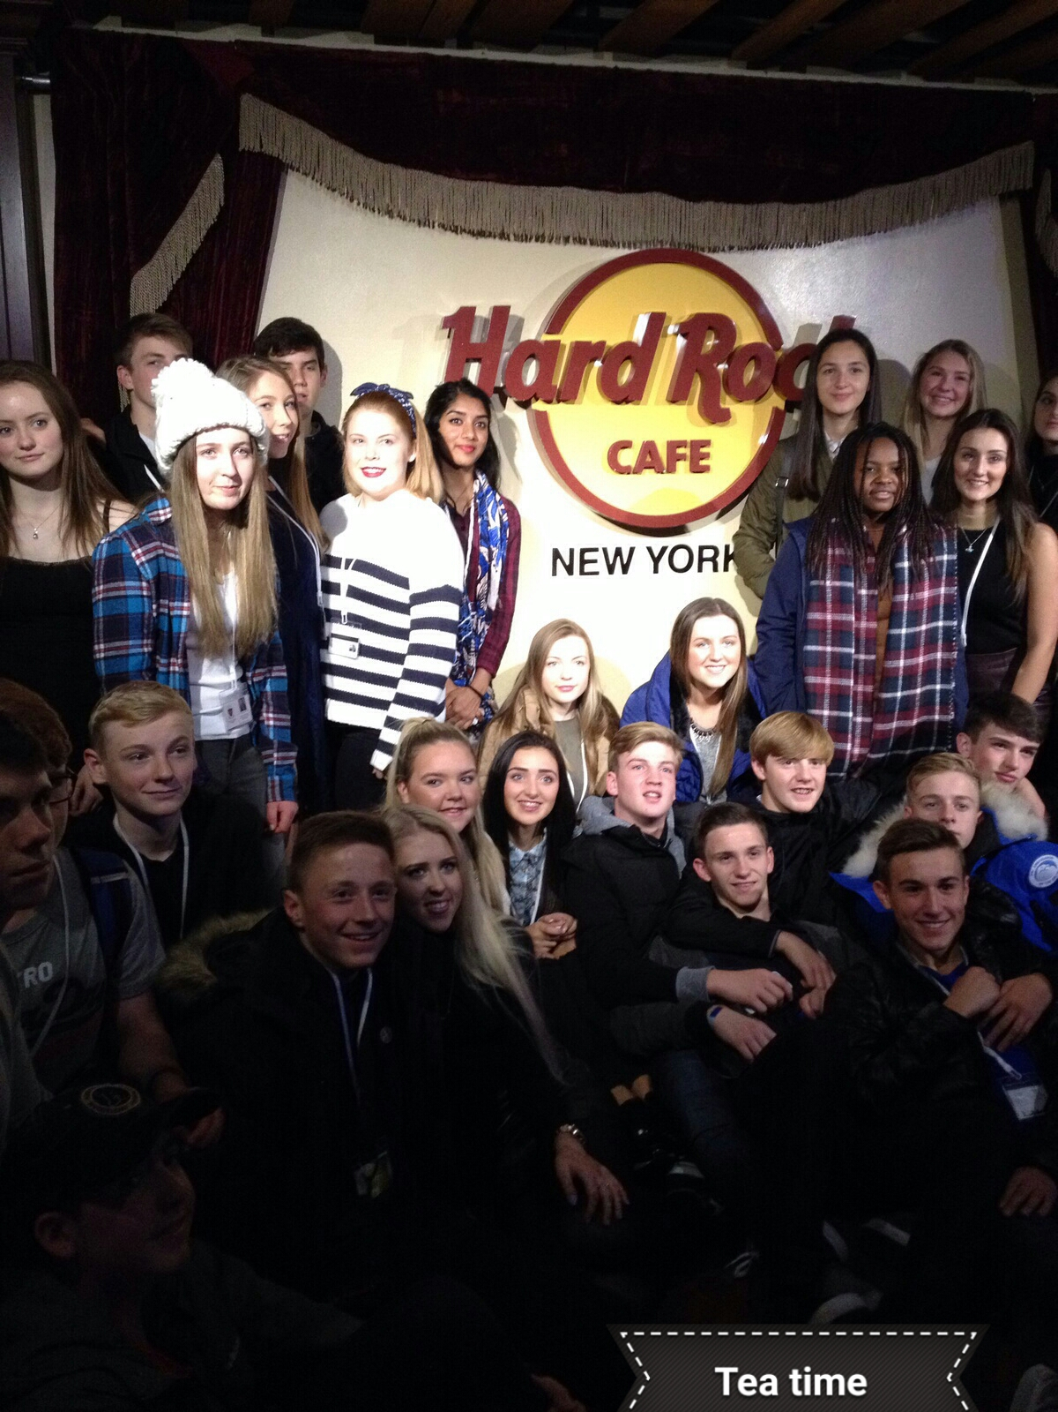
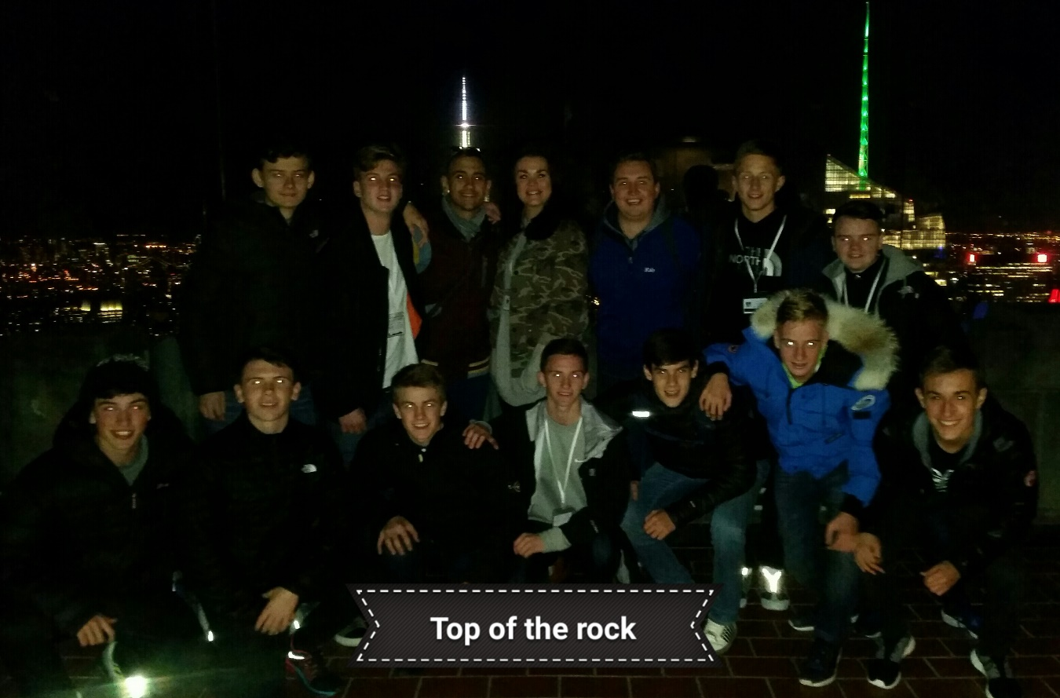
Memories of last year…

Slide 23
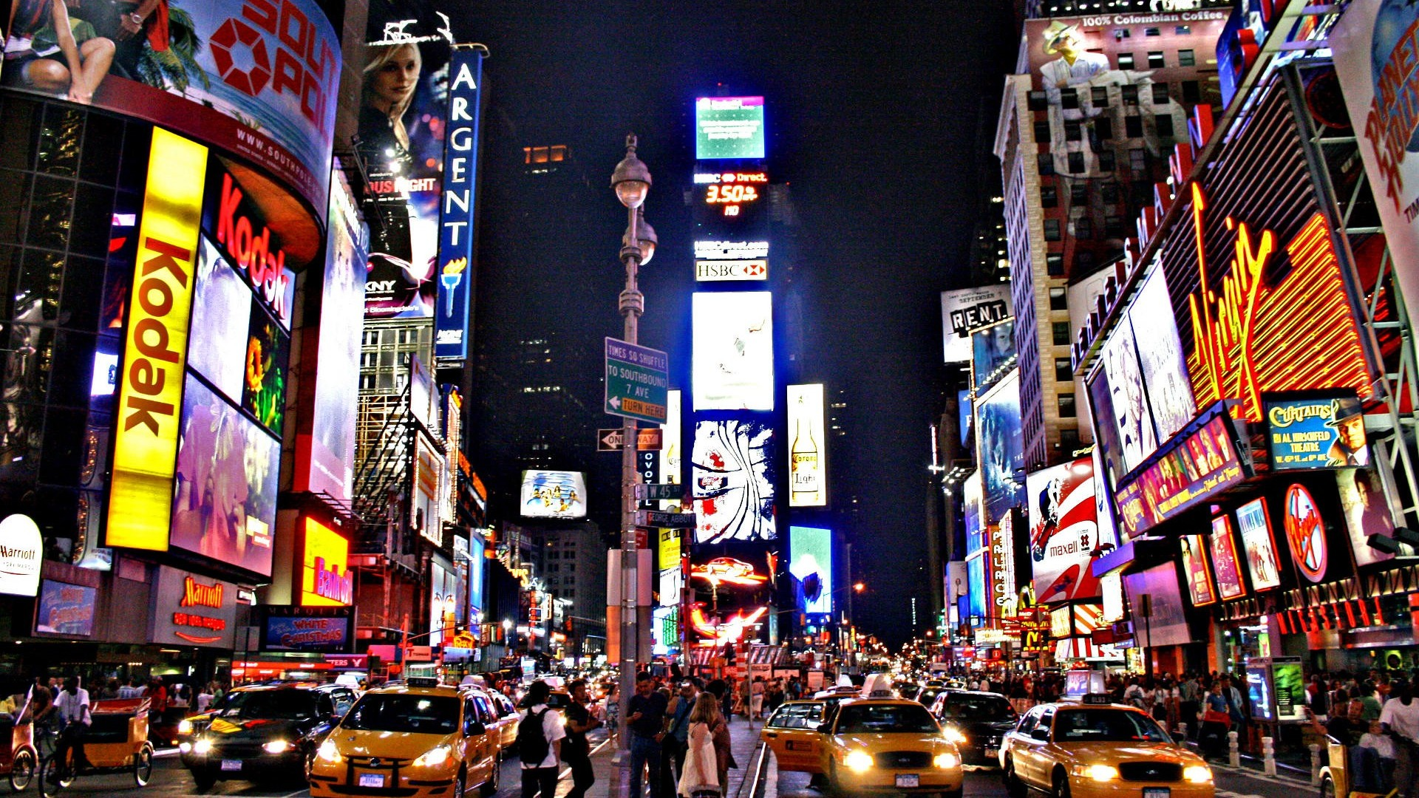

Slide 24
NEW YORK TRIP
13th February – 17th February 2017

Slide 25
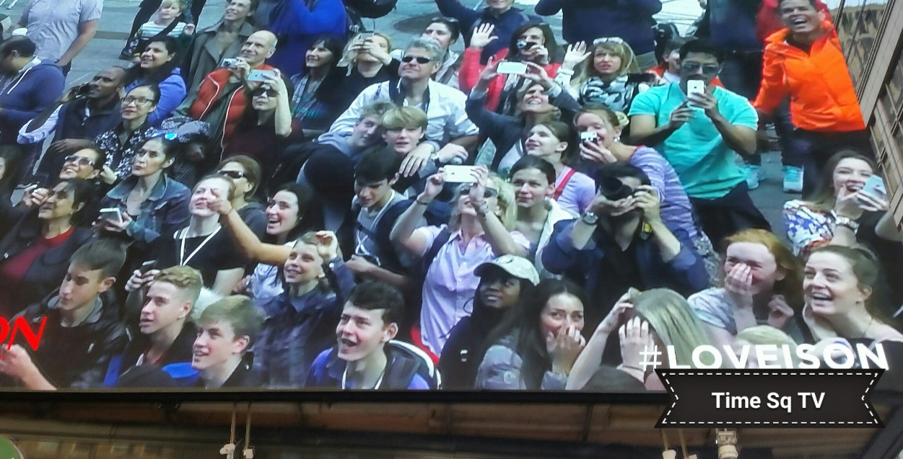
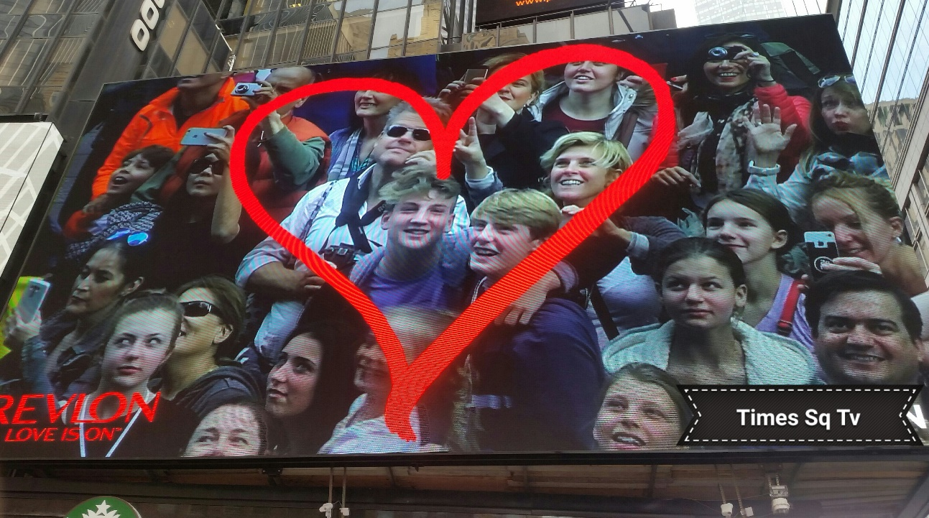
Memories of last year…

Slide 26
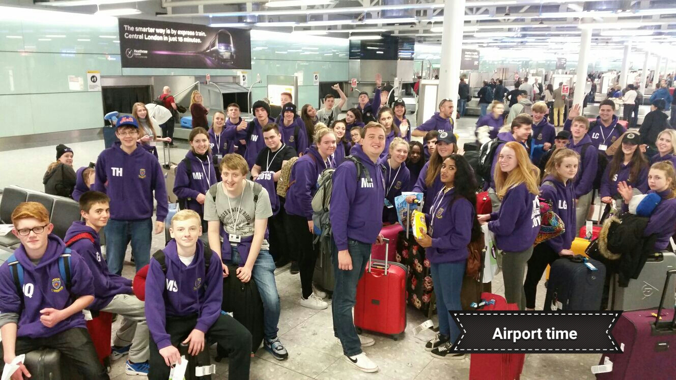
Memories of last year…

Slide 27
What our Pupils told us last year…
‘100% the best trip I have ever been on. I made so many memories, became closer to other people in my year, and overall had a fab time’ – Isabelle Rowan

Slide 28
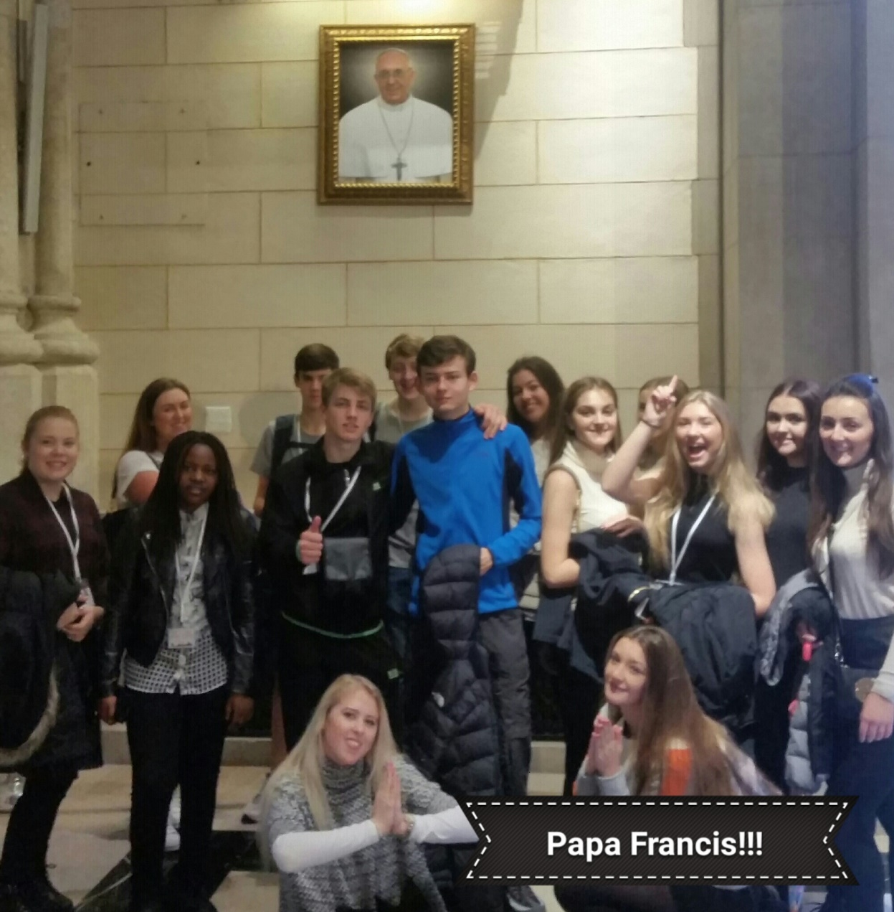
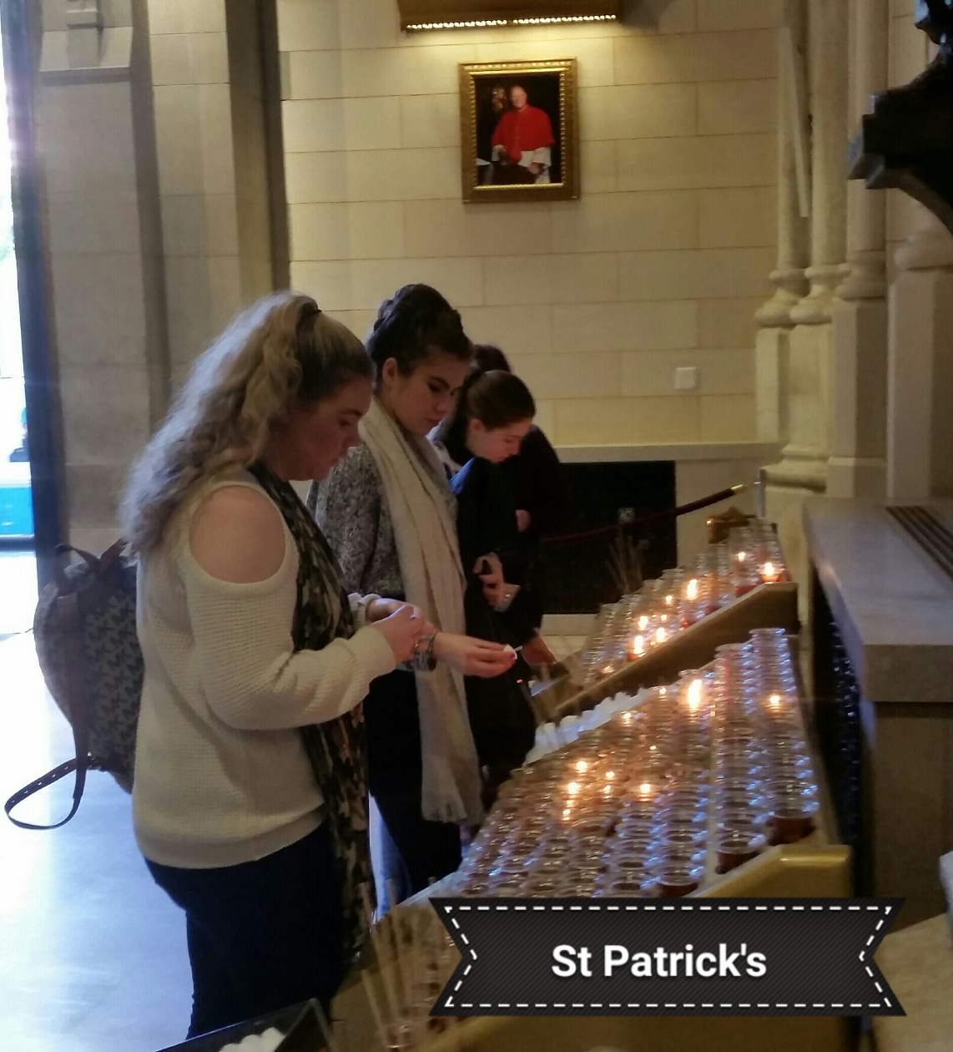
Memories of last year…

Slide 29
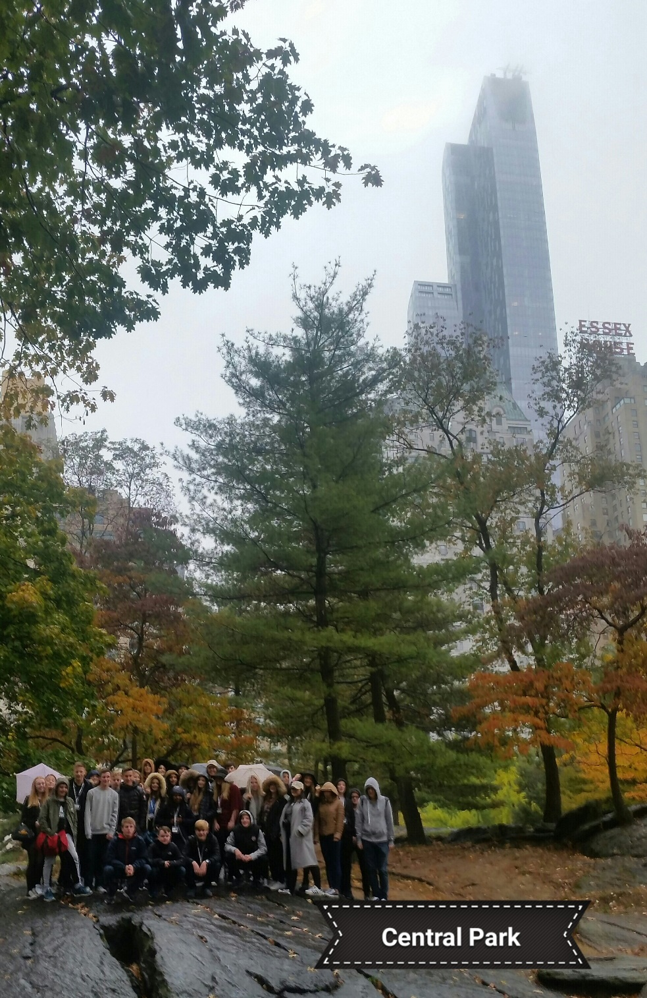
Memories of
last year…

Slide 30
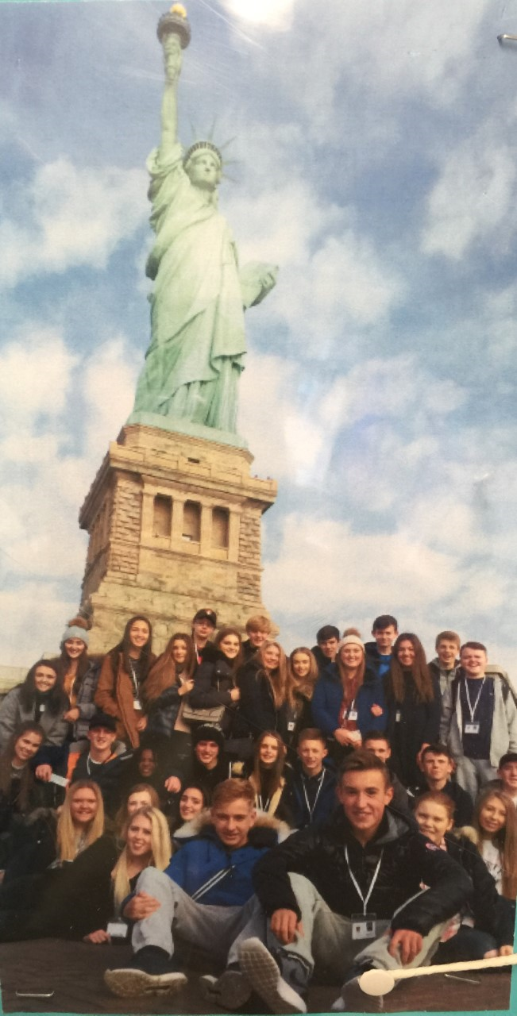
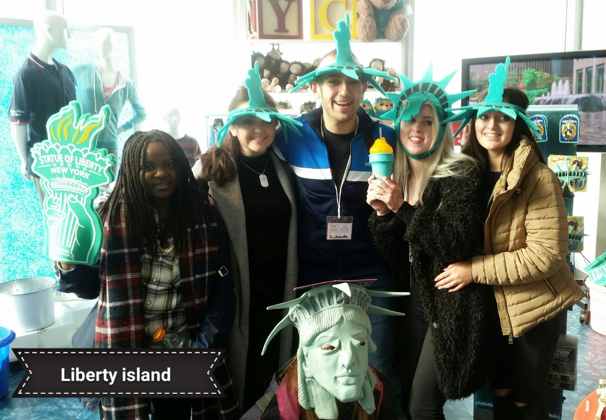
Memories of
last year…

Slide 31
Why RE & NYC?
To visit St. Patrick’s Cathedral including St. JBDLS’ Side-Altar

Slide 32
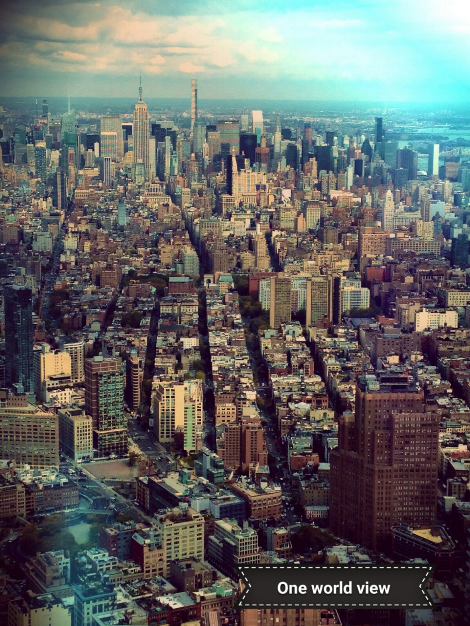
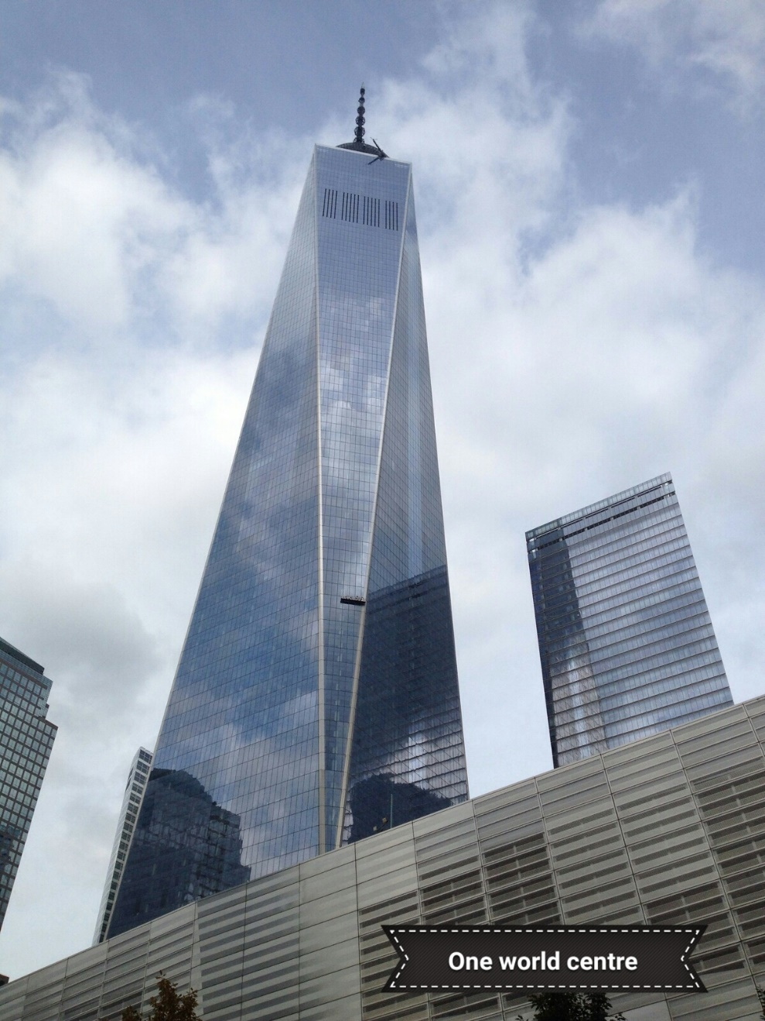
Memories of last year…

Slide 33
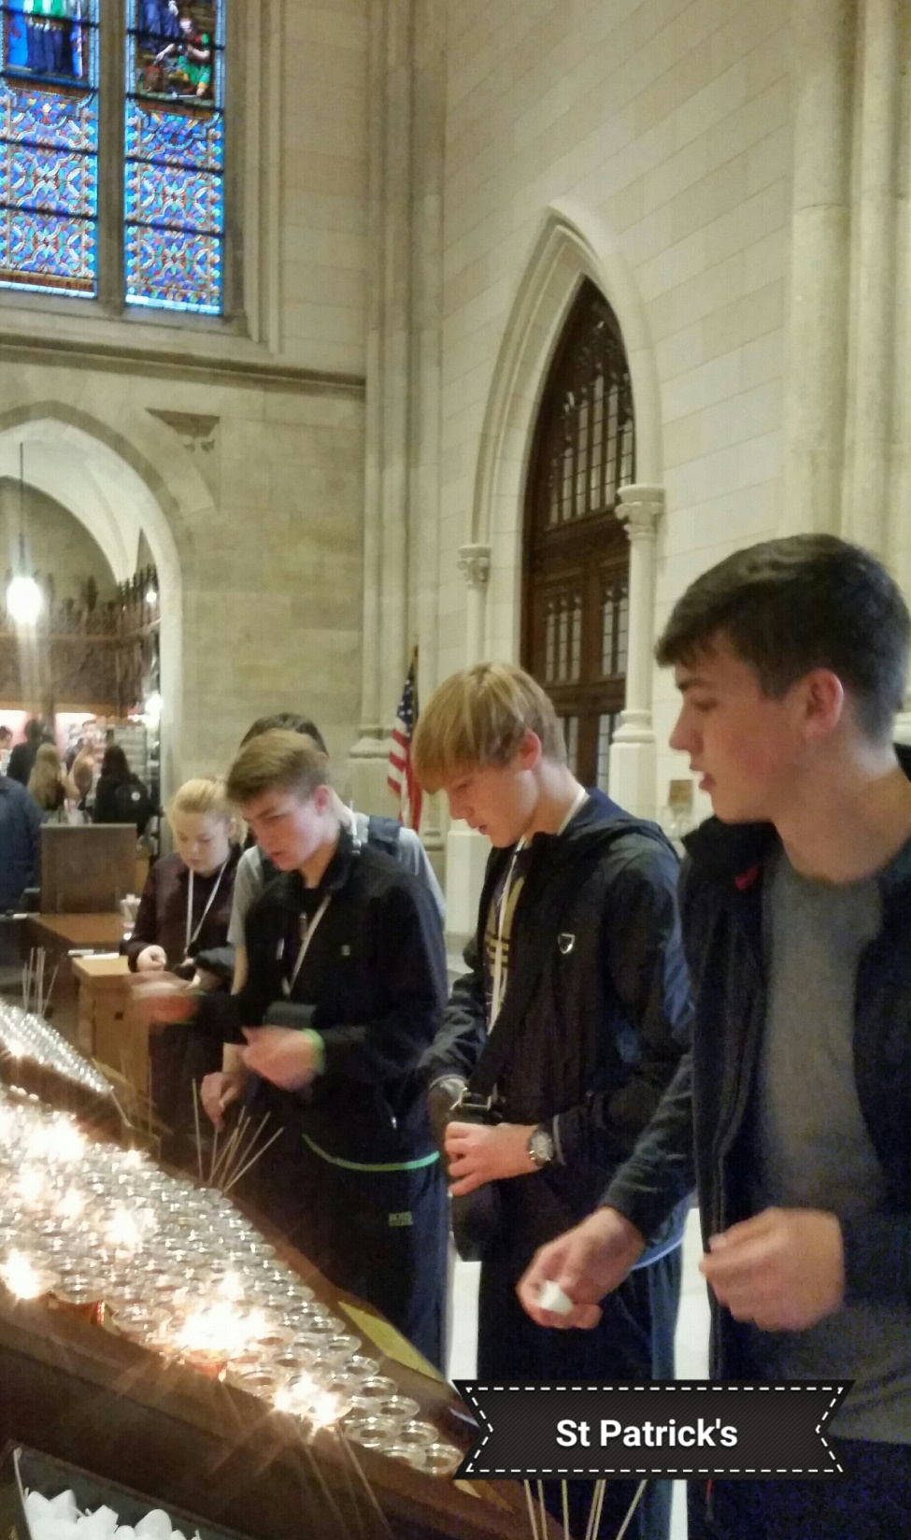
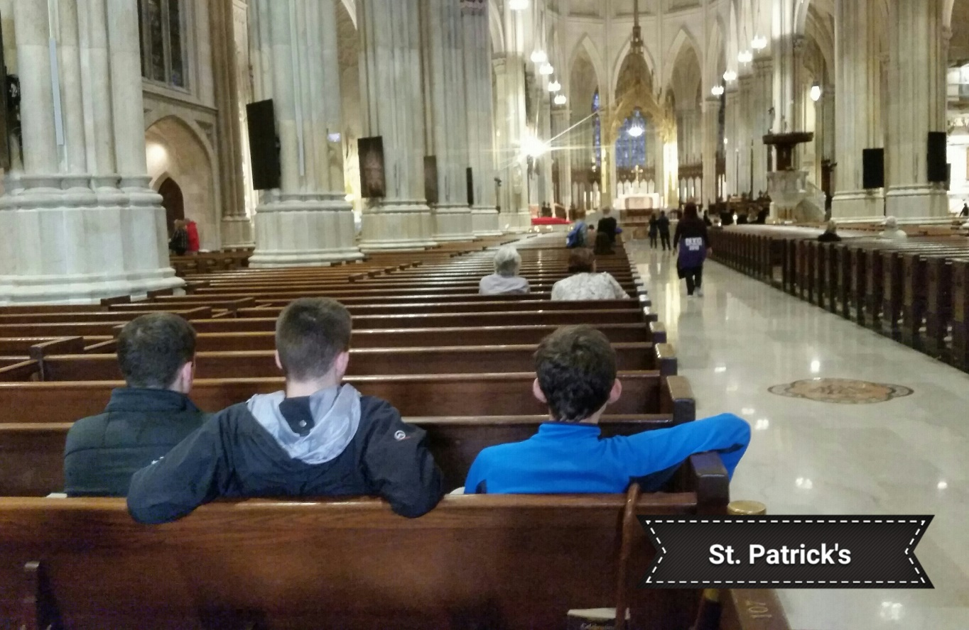
Memories of
last year…

Slide 34
What our Pupils told us last year…
‘I enjoyed learning more about The UN. It made me realise how fortunate I am compared to other people in the world’
– Lorna Glenn

